Slide 1
Employee Data Analysis using Excel
STUDENT NAME ; JAYALAKSHMI TS
REGISTER NO : 2213391036220
DEPARTMENT : B.COM GENERAL
COLLEGE : Queen mary’s college

Slide 2
PROJECT TITLE
Employee Performance Analysis
Using Excle

Slide 3

AGENDA
1. Problem statement
2.project Overview
3. End Users
4.Our solution and
Proposition
5. Dataset Description
6. Modelling Approach
7. Results and discussion
8. Conclusion

Slide 4
PROPLEM STATEMENT
Performance analysis are made to a employee
Increment to check the Performance track of
The employee personal as well as organization
Growth.
So, the employee Performance analysis helps
to require all the problem and have a
Successful organization .

Slide 5
PROJECT OVERVIEW
Analysing the performance of the
employee by considering the various
factory like ;
Gender,
performance score and
Ratings.
Their involvement work and various scores
that analysis the performance of employees
in the organization .

Slide 6

WHO ARE THE END USERS ?
Employees Emplyer Manager ,
Gets benefits from the performance of appraisal

Slide 7
OUR SOLUTION AND ITS VALUE PROPOSITION
Conditional formatting _ missing valus
Filtering : remove missing data
pivot : Summary
Graph : data visualisation

Slide 8

DATASET DESCRIPTION
EMPLOYEE DATASET KIGGLE
There are 26 features but we consider 9 features
Employees ID Numerical data
Name Text
Performance Level
Gender Male or Female
Employees rating Numerical data.

Slide 9
THE “WOW” IN OUR SOLUTION
Sample Queries :
Get all characters in a guild *FROM Characters JION
Members ON Characters ID =CHARACTER ID WHERE GuildID =
[GUILDID ]
3. Get all raids a character has participated in : SELECT *FROM
4Raids JION Raidmambers ON RaidID = WHERE characterID
=[CharactersID ]
This database design captures key WoW data and relationships
Enabling you to store

Slide 10
MODELLIN G
Data collection
Features collection
Data cleaning
Summary
Visualisation

Slide 11
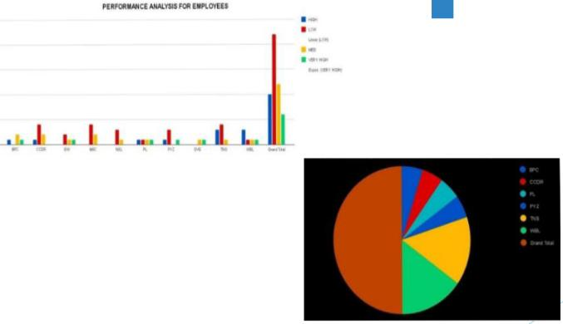
RESULTS

Slide 12

CONCLUSION
While comparing tha performance of
Employees , the number of employees are
Higher in number is in the average
Performance where excellence employees are
Less in percentage. So to overcome this we
Should motivate the employee by giving there
Different tasks based on their skills to improve their performance in their work .

Slide 13
Thank you 🙏

